Slide 1
CS112 : Introduction to Python Programming
Week 1: Introduction

Slide 2
Contents
Instructor & TAs
Course Info
Programming Intro
Python Basics

Slide 3
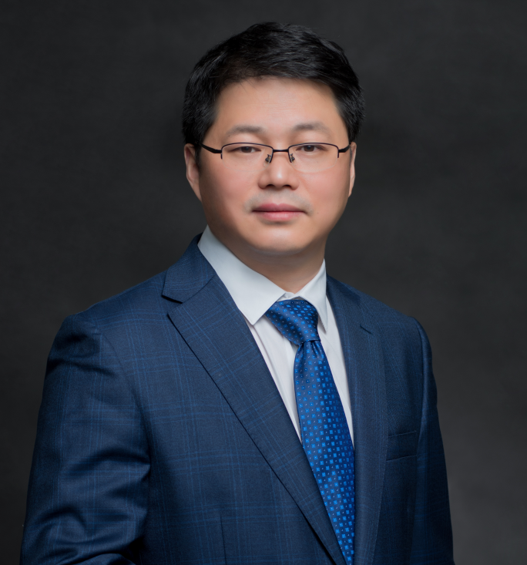
Instructor
B.S. in Prevention Medicine, Tongji Medical University
M.S and Ph.D. in Epidemiology, HUST
Research interests:
Epidemiology of diseases
Foods safety assessment
Office: 创园7栋205
Email: weis@sustech.edu.cn
WEI Sheng (魏晟)
Professor
School of Public health and emergency manegment

Slide 4
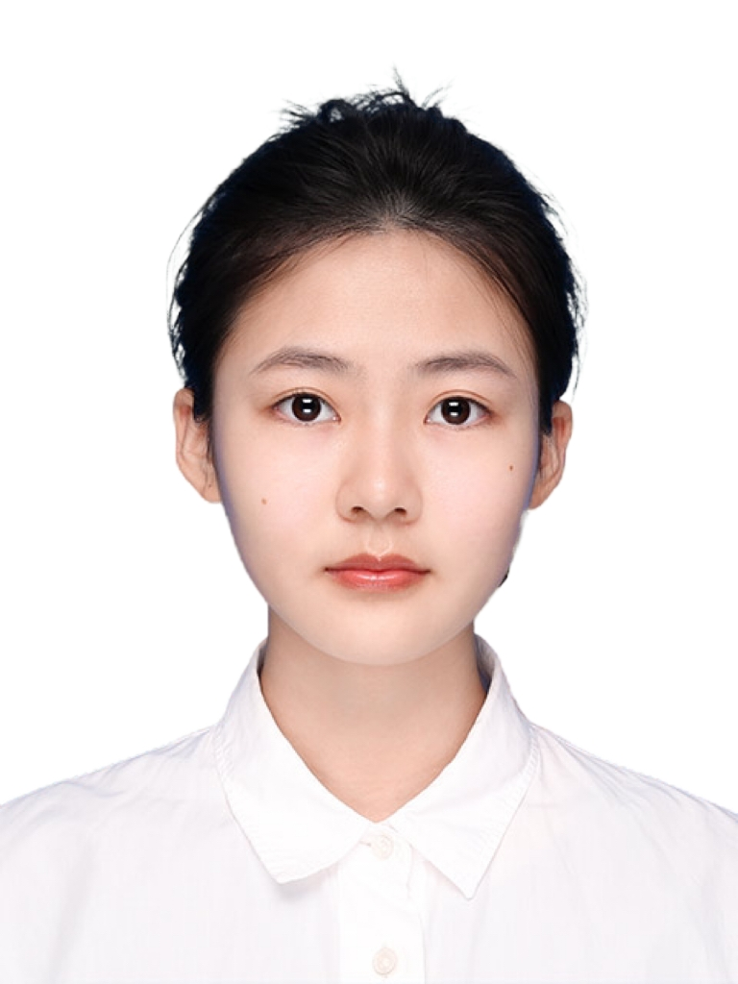
TA
Engineering Master Student of 2023
Dept. of Computer Science and Engineering
Research Interests : Machine Learning
Contact :12332454@mail.sustech.edu.cn
YANG Zhi (阳芷)

Slide 5

TA
Engineering Master Student of 2023
Dept. of Computer Science and Engineering
Research Interests: Machine Learning
Contact :yerg2023@mail.sustech.edu.cn
YE Rongguang(叶荣光)

Slide 6
About this course
Time and place:
Lecture:
Week 1-16, Wednesday 4:20-6:10 pm, Room 202, Lecture Hall 3
1-16周 星期三 第7-8节 三教202
Lab:
Week 1-16, Wednesday 7:00-8:50 pm, Room 511, Lecture Hall 3
1-16周 星期三 第9-10节 三教511机房
Format:
Lectures
Practices
Assignments
Quiz

Slide 7
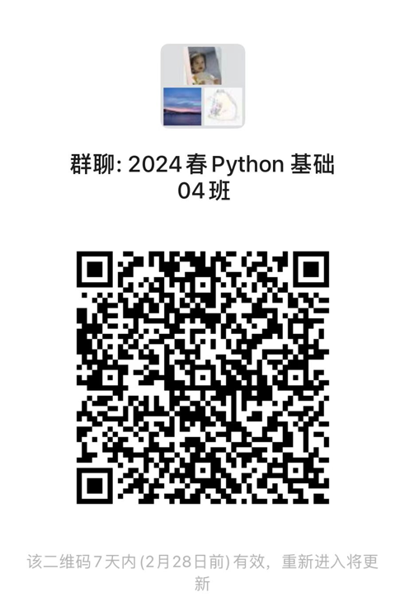
Course platforms

Slide 8
Prerequisite
Familiar with at least one operation systems (Windows, Mac or Linux)
No need to have programming experience
0基础

Slide 9
Course objectives
Understand the basic principles and syntax of python programming
Be able to read and write files and write simple programs using python
Familiar with commonly used Python packages, including NumPy, SciPy, Pandas, Matplotlib, etc
Be able to use data visualization tools such as Matplotlib and Seaborn

Slide 10
Grading
Attendance: 10%
Assignments: 30%
Quiz: 30%
Final exam: 30%

Slide 11
Academic misconduct
If an undergraduate assignment is found to be plagiarized (抄袭), the first time the score of the assignment will be 0.
The second time the score of the course will be 0.
Print the Undergraduate Students Assignment Declaration Form (本科生作业承诺书) from BB and sign. Submit it on BB.

Slide 12
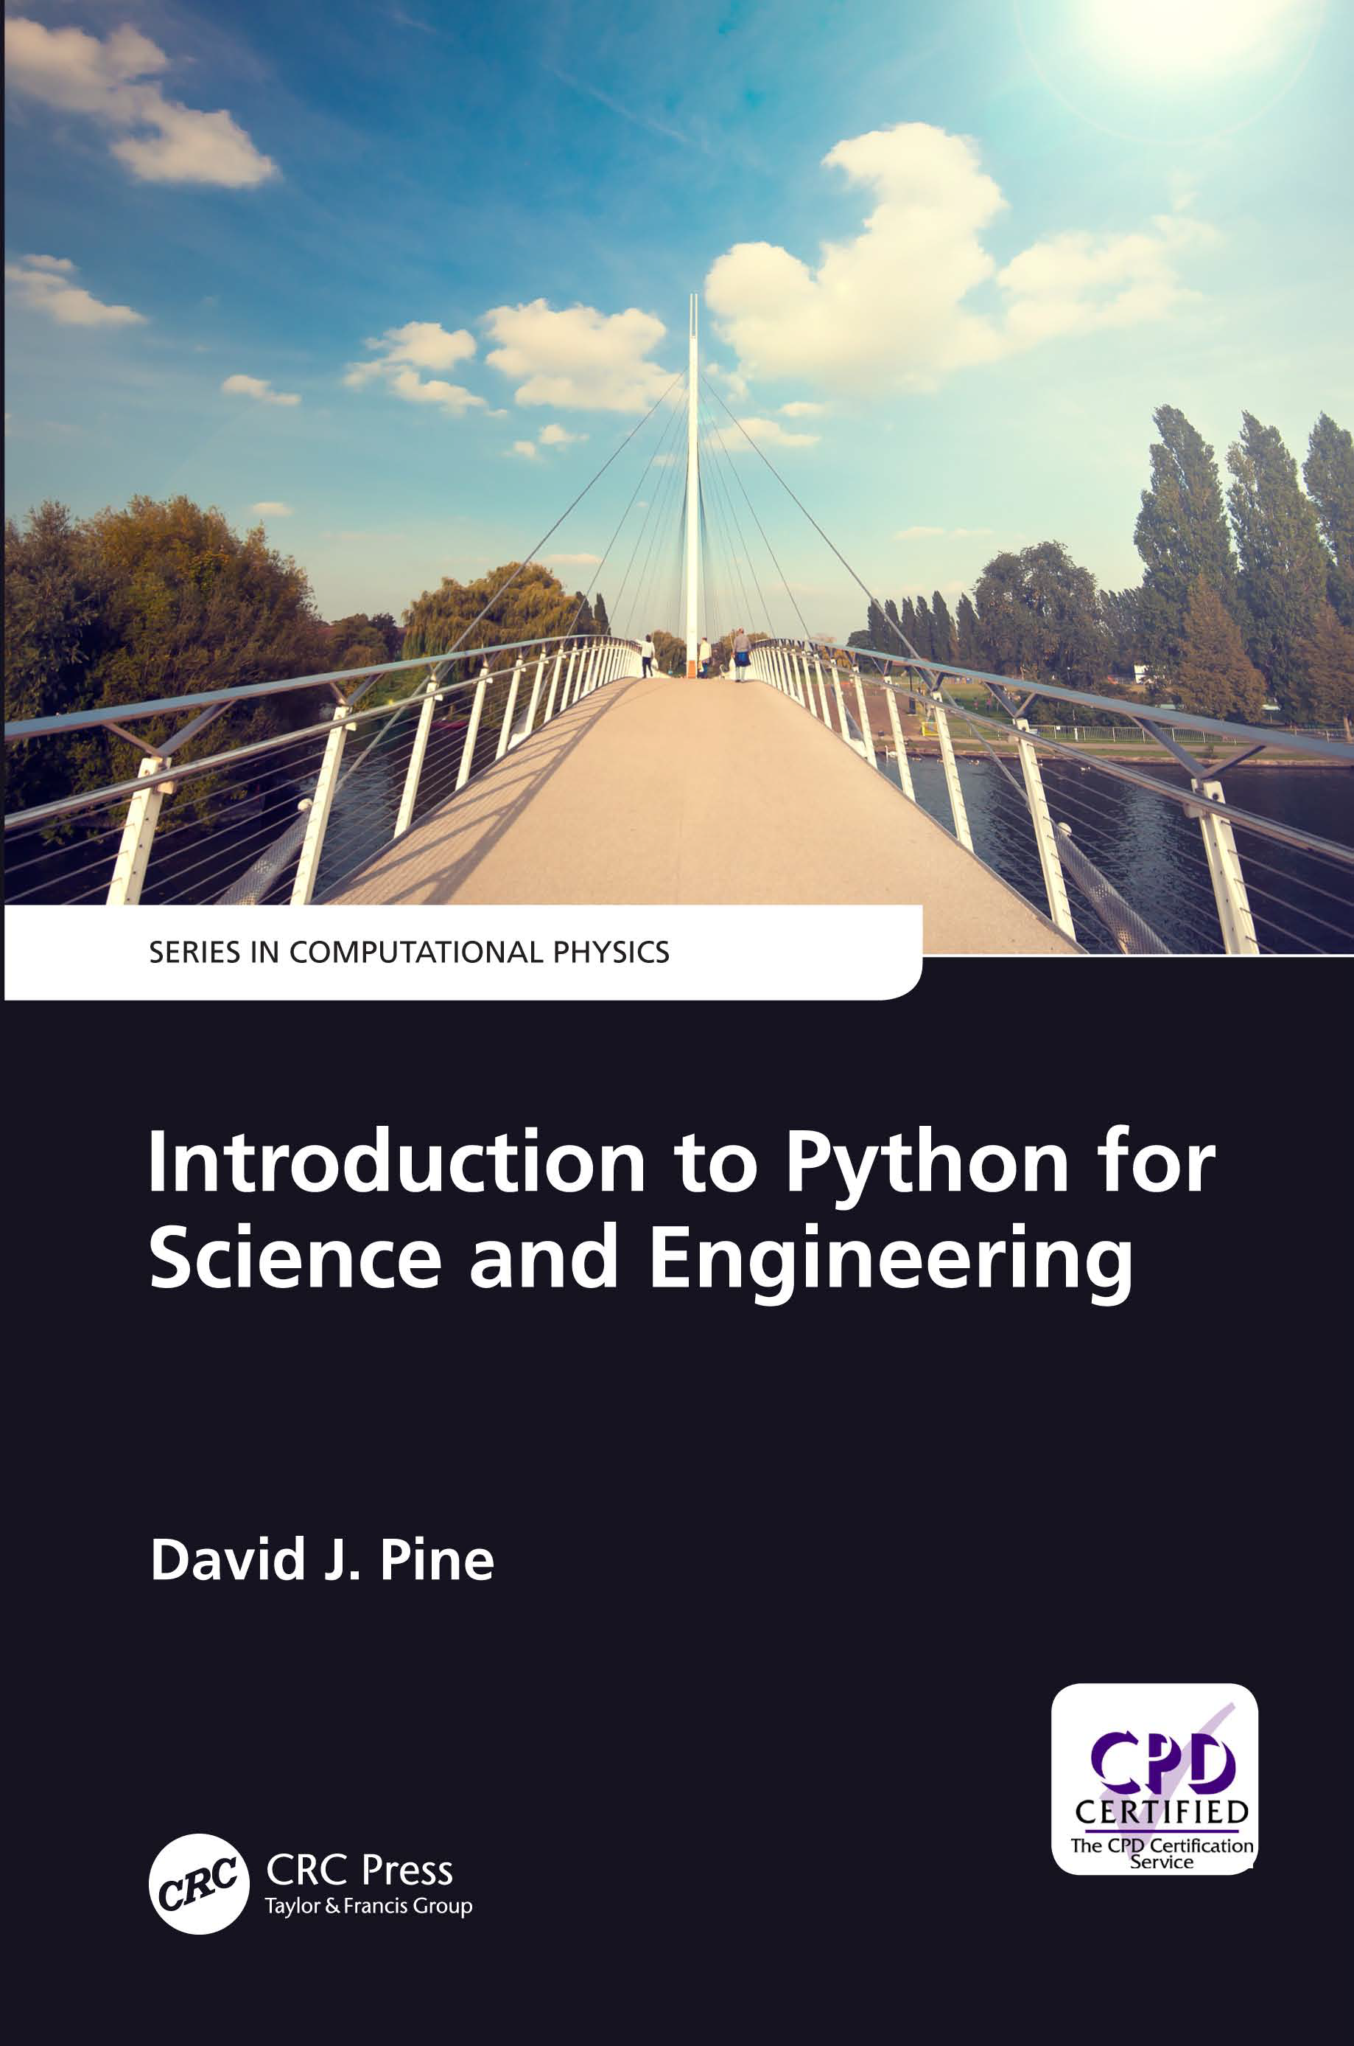
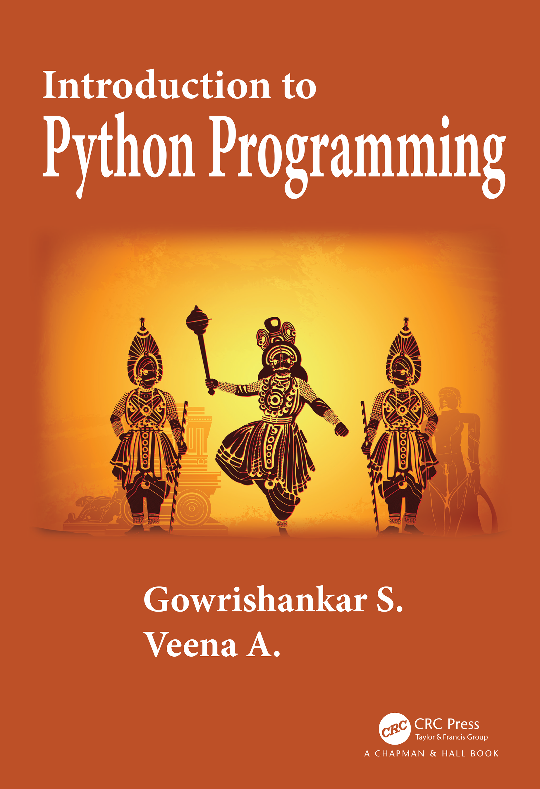
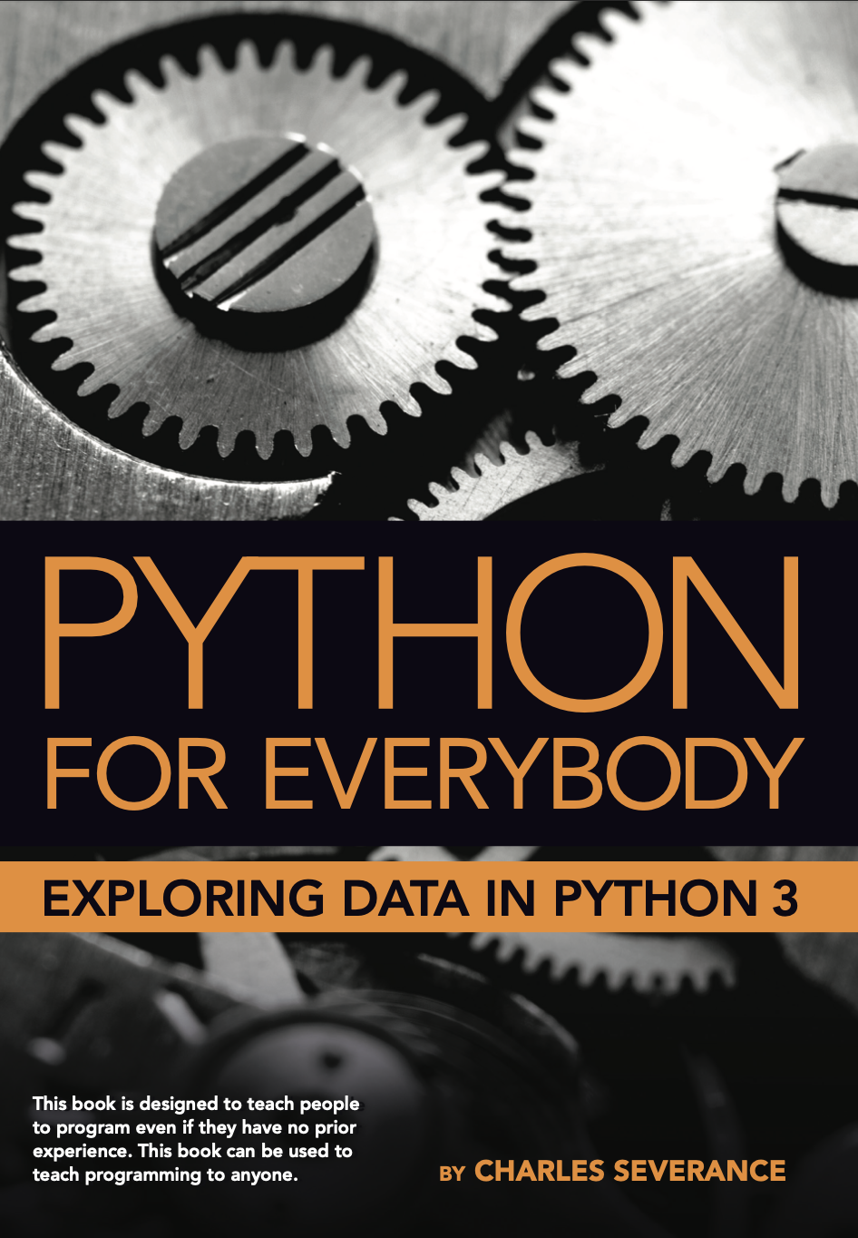
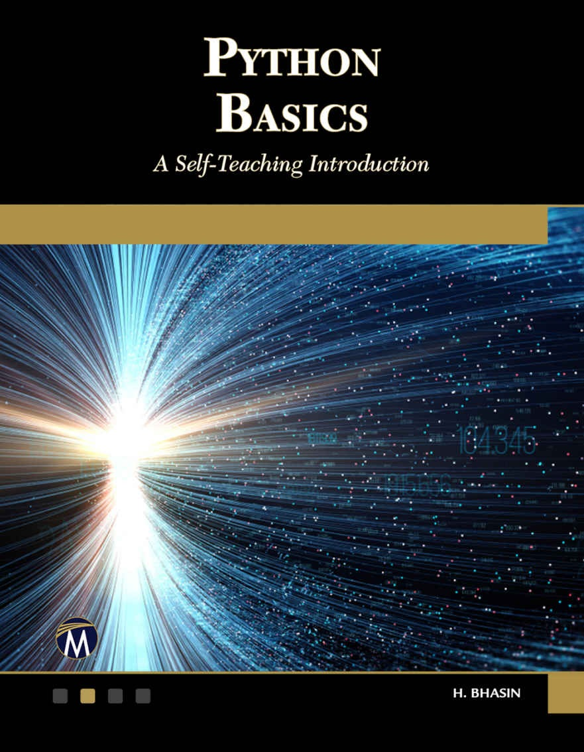
Textbooks
David J. Pine, 2019, Introduction to Python for Science and Engineering, CRC Press
Gowrishankar & Veena, 2019, Introduction to Python Programming, CRC Press
Charles Severance, 2016, Python for Everybody: Exploring Data Using Python 3, CreateSpace Independent Publishing
H. Bhasin, 2020, PYTHON BASICS – A Self-Teaching Introduction, New Age International Publishers

Slide 13
Syllabus
Week | Content | Assignment / Quiz
Week 1 | Introduction; Anaconda & Jupyter Notebook
Week 2 | Data types I
Week 3 | Data types II | Assignment 1
Week 4 | Flow control I
Week 5 | Flow control II | Quiz 1, Assignment 2
Week 6 | Input and output I
Week 7 | Input and output II | Assignment 3
Week 8 | Functions
Week | Content | Assignment / Quiz
Week 9 | Class | Quiz 2, Assignment 4
Week 10 | Numpy & Scipy I
Week 11 | Numpy & Scipy II | Assignment 5
Week 12 | Pandas I
Week 13 | Pandas II | Assignment 6
Week 14 | Data Visualization I | Quiz 3
Week 15 | Data Visualization II
Week 16 | Basic statistics in Python

Slide 14
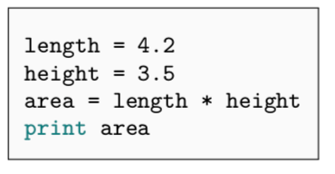
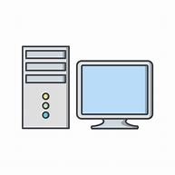
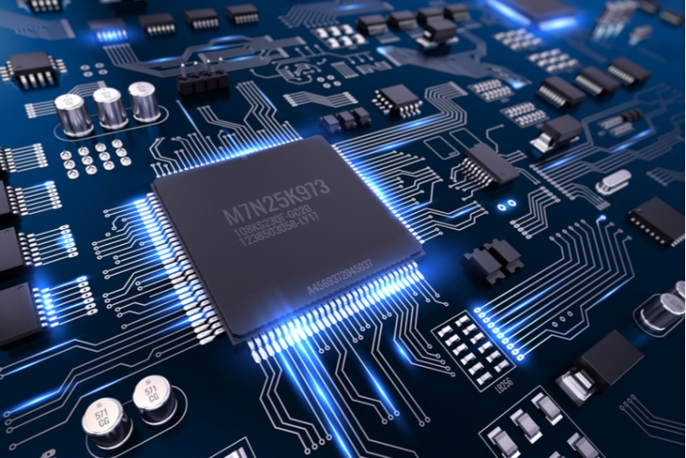
What is a program?
A program is a set of ordered instructions designed to command the computer to do something.
14.7

Slide 15
Programming languages
A programming language is a computer language engineered to communicate instructions to a machine.

Slide 16
Machine Language (机器语言)
A low-level computer language that is designed to be directly understandable by a computer.
Entirely comprised of binary, 0’s and 1’s, e.g., 00100100
All programs must be converted into machine language before they can be run
Can run and execute very fast
Almost impossible to read; hard to maintain and debug
Hello World.
01001000 01100101 01101100 01101100 01101111 00100000 01010111 01101111 01110010 01101100 01100100
“There are 10 kinds of people in the world: those who understand binary numerals, and those who don’t.”
— Ian Stewart

Slide 17
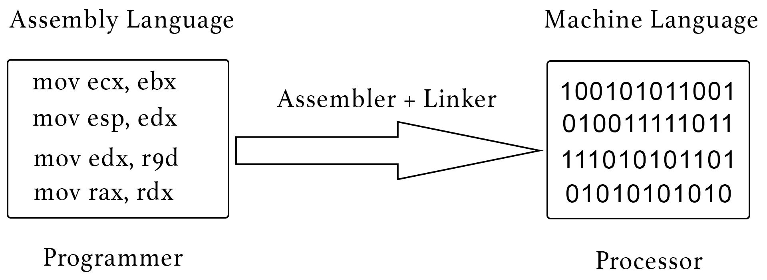
Assembly language (汇编语言)
Human readable notation for the machine language
Known as Symbolic Programming Language （符号语言）
Assembler (汇编器) must be used to convert assembly language to machine language
Still difficult for human to read; hardware-dependent; difficult for portability

Slide 18
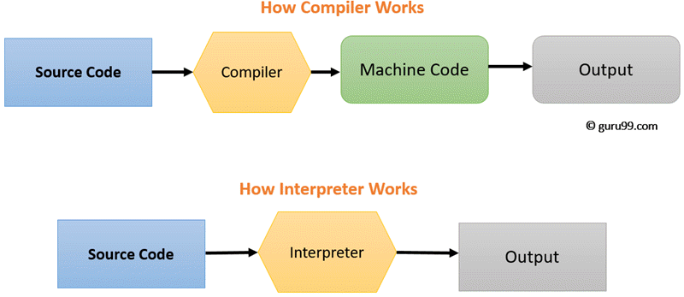
High-level language (高级语言)
Close to human language
Platform independent
Easier to modify, faster to write code and debug
Must be translated into machine language before it can run (by either compiler(编译器) or interpreter(解释器) )
Compiled languages:
C/C++, Fortran, Java, C#
Interpreted languages:
Python, MATLAB, Ruby, Perl
Notes:
解释器（英语：interpreter），是一种计算机程序，能够把解释型语言解释执行。解释器就像一位“中间人”。解释器边解释边执行，因此依赖于解释器的程序运行速度比较缓慢。解释器的好处是它不需要重新编译整个程序，从而减轻了每次程序更新后编译的负担。相对的编译器一次性将所有源代码编译成二进制文件，执行时无需依赖编译器或其他额外的程序。
编译语言（英语：Compiled language）是一种编程语言类型，通过编译器来实现。它不像解释型语言一样，由解释器将代码一句一句执行，而是以编译器，先将代码编译为机器代码，再加以执行。理论上，任何编程语言都可以是编译式，或直译式的。它们之间的区别，仅与程序的应用有关。

Slide 19
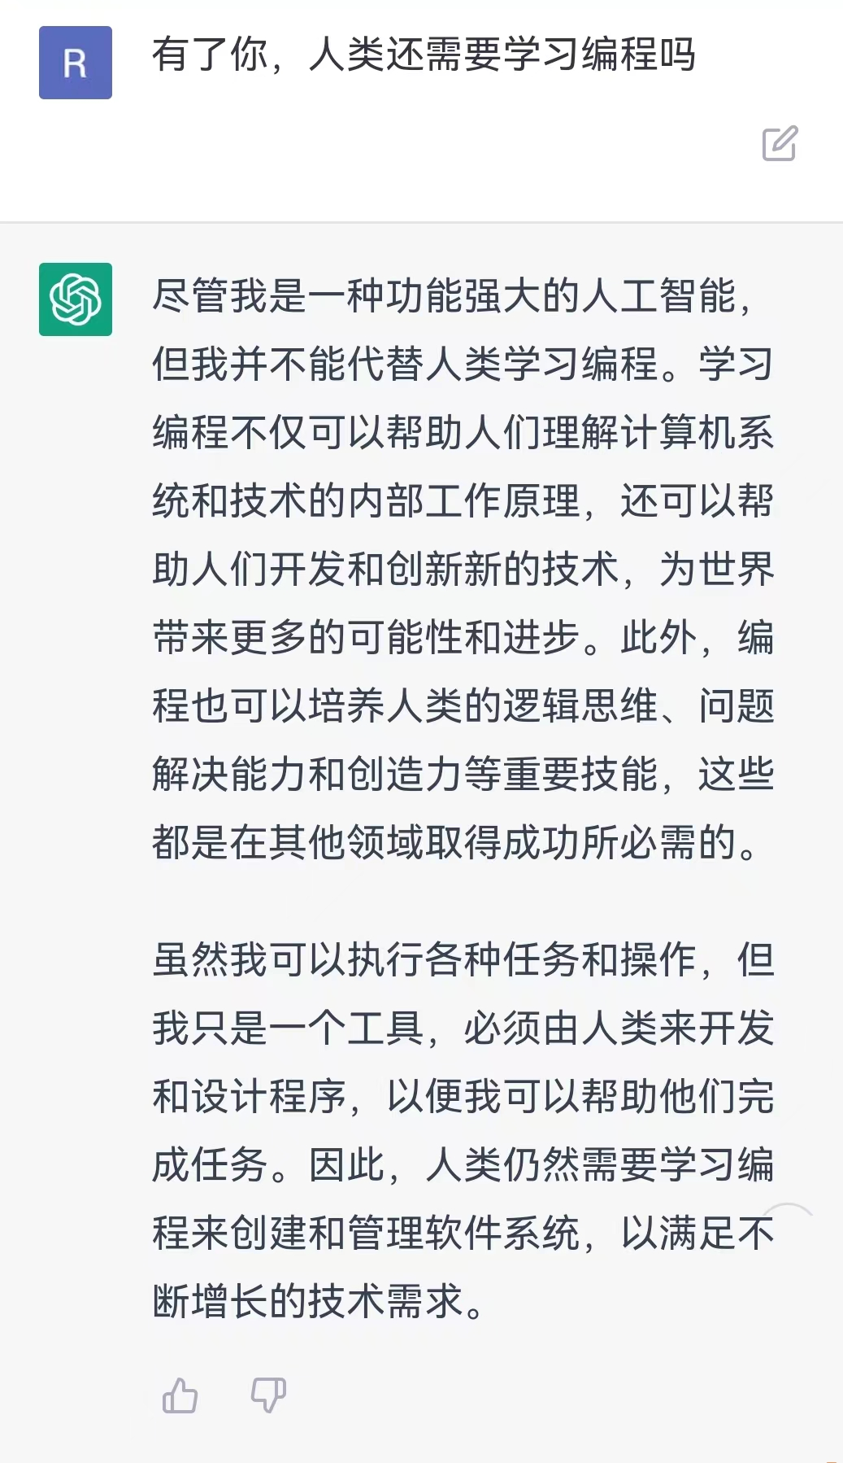
Why do we need to learn programming?

Slide 20
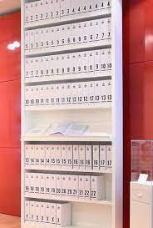
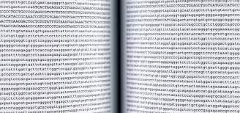
Why do we need to learn programming?
1. Data analysis
The Human Genome Project : 1990-2003
How to analyze?
How to understand?
How to extract useful information?
From internet

Slide 21
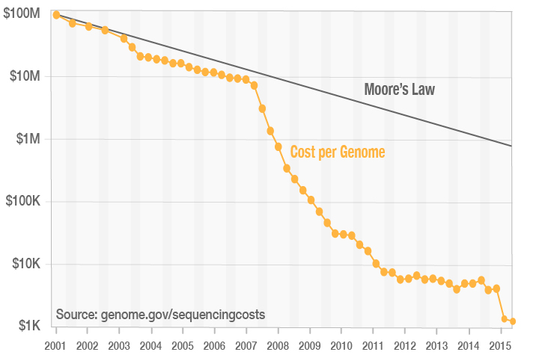
Why do we need to learn programming?
1. Data analysis
Big data in biomedical research:
Multi-omics （多组学）
Transcriptomics
Epigenomics
Proteomics
Single cell multi-omics
...
High-throughput experiments:
Drug discovery
Genetic screening
…
Moore's law: the number of transistors on a microchip doubles about every two years.

Slide 22
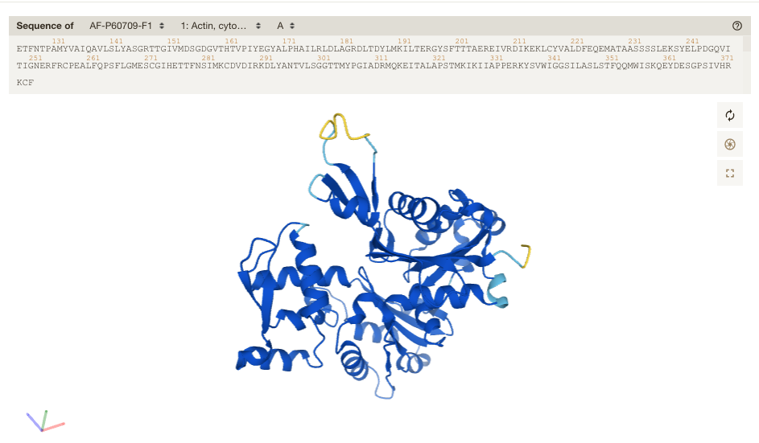
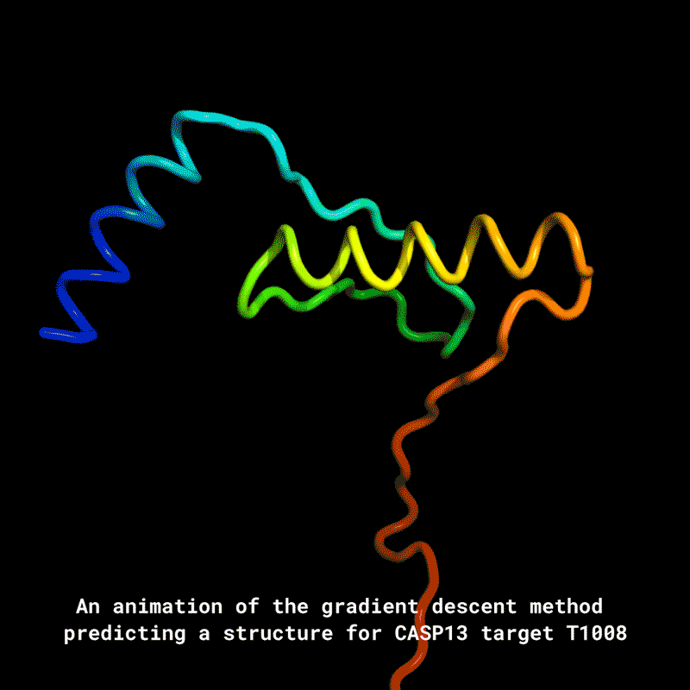
Why do we need to learn programming?
2. In silico modeling & prediction
AlphaFold: structure prediction
Molecular dynamics
From internet
Notes:
ACTIN vs. MAPT

Slide 23
Why do we need to learn programming?
2. In silico modeling & predicting
Simulate the epidemic of disease
Computational protein design
In silico drug discovery
Computational Metabolic analysis
…

Slide 24
Why do we need to learn programming?
3. Data visualization

Slide 25
Why Python?
Python is an interpreted, high-level, and general-purpose programming language
Open-source, readable, easy-to-learn, easy-to-use
Excellent packages support and large developer community
Widely accepted as the best programming language to learn first; a must-learn language in data science or AI industry

Slide 26
Why Python?
Life is short, you need Python"
----Bruce Eckel
人生苦短，我用Python！
---Guido van Rossum

Slide 27
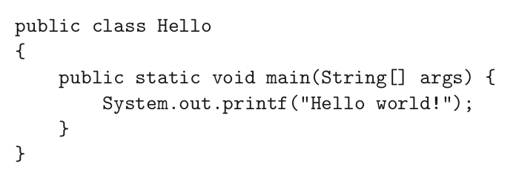
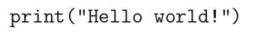
Why Python?
Readability
For example: A“hello world”program
in Python:
in Java:

Slide 28
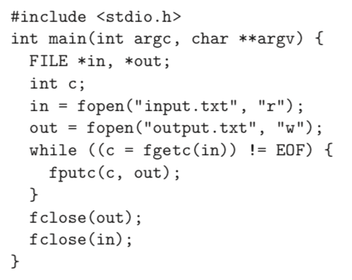
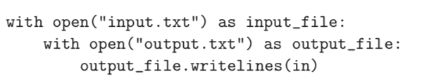
Why Python?
Readability
For example: Read a file and copy it into another file
in C:
in Python:

Slide 29
Why Python?
Availability of third-party modules/packages
For example:
Data analysis: Numpy, Scipy, …
Machine learning: PyTorch
Data visualization: Matplotlib, Seaborn, Plotly, …
Bioinformatics analysis: BioPython, Scanpy, …
Image processing: scikit-image, …
…

Slide 30
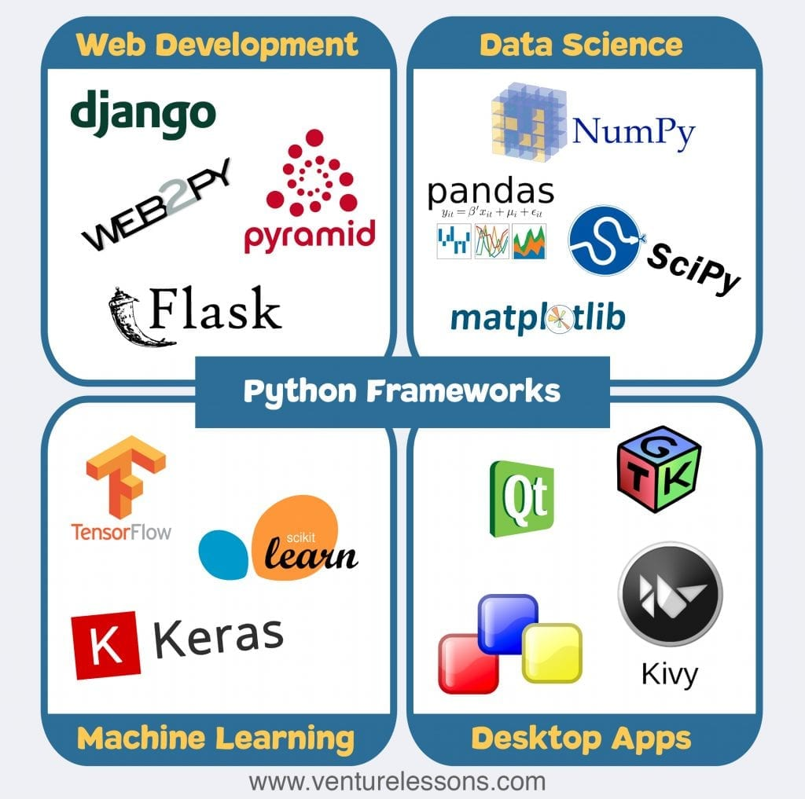
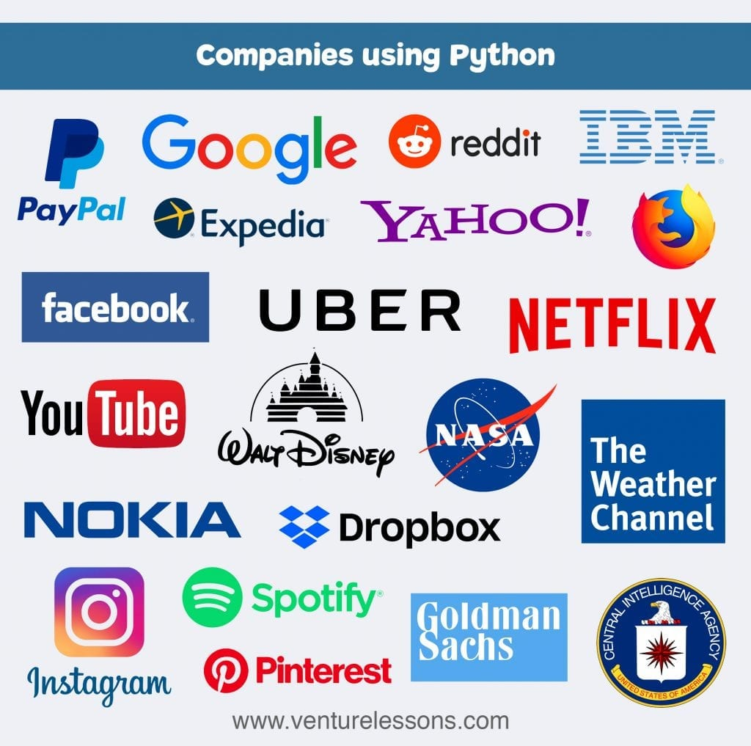

Why Python?
Python has been widely used in many areas:
Many applications have been developed using Python

Slide 31
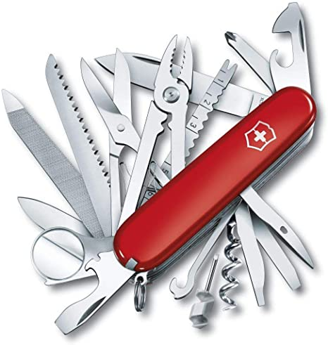

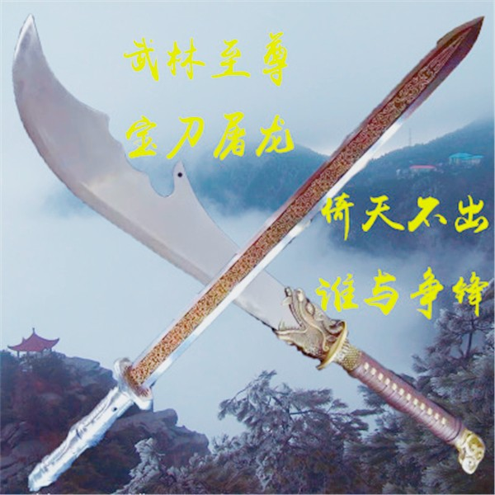
Why Python?
Python
Python is a Swiss Army knife.
C/C++
C/C++ is a treasured sword.
http://xkcd.com/353/

Slide 32
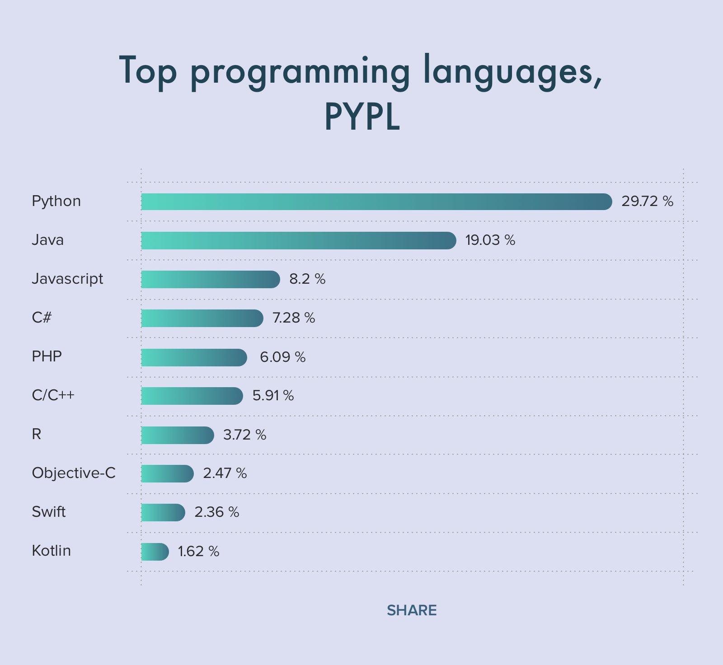
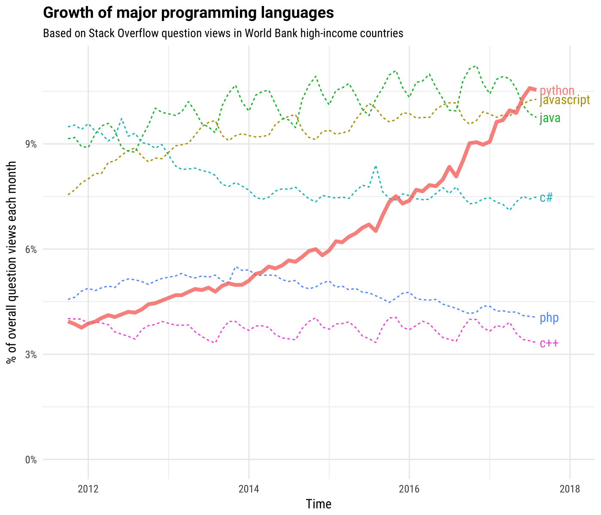
Why Python?
Programming is fun! Python is fun!
Life is short, use Python!
Python has become one of the most popular programming languages
2021
Source: https://stackoverflow.blog

Slide 33
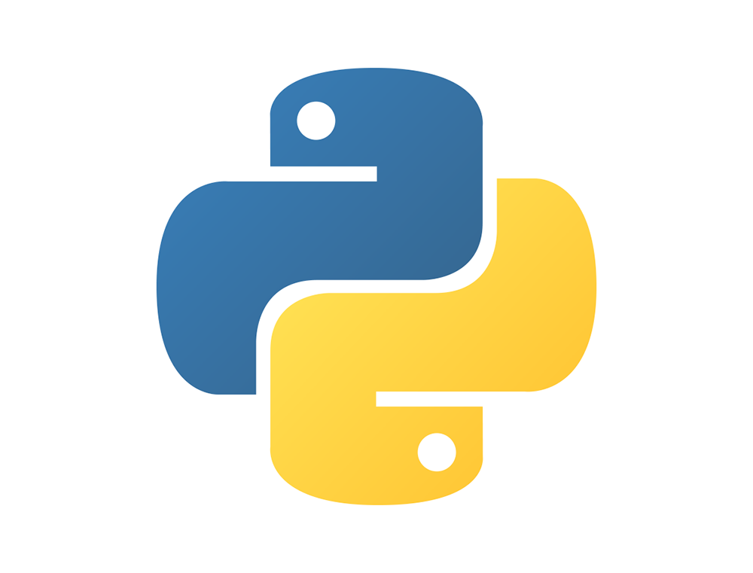
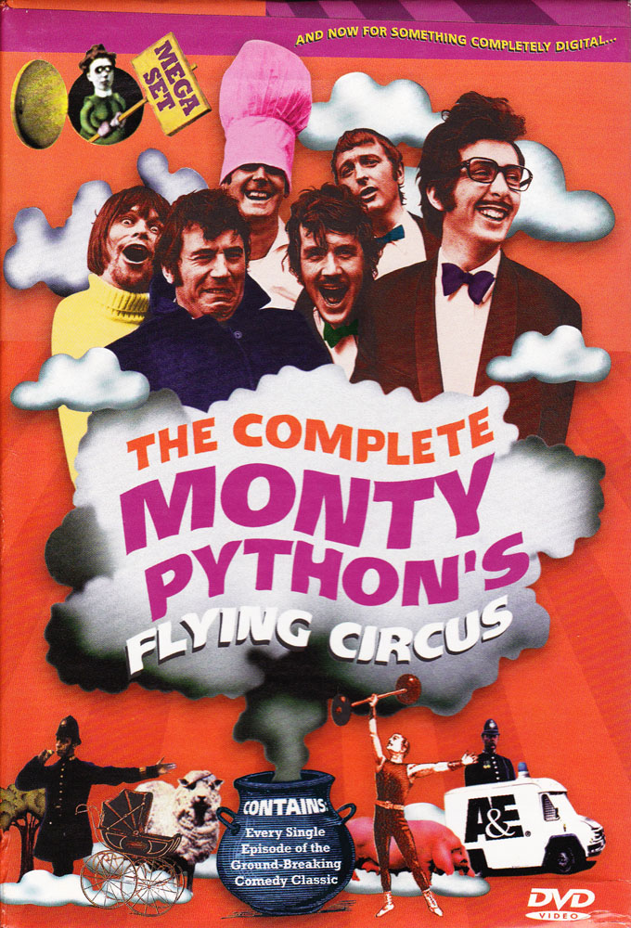

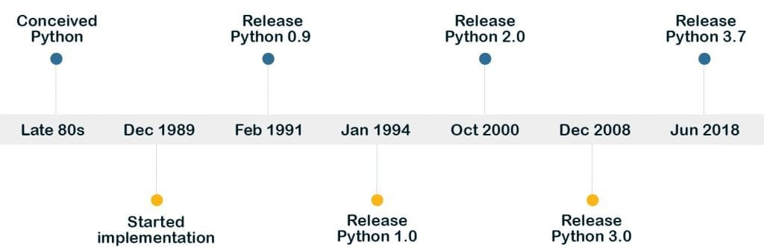
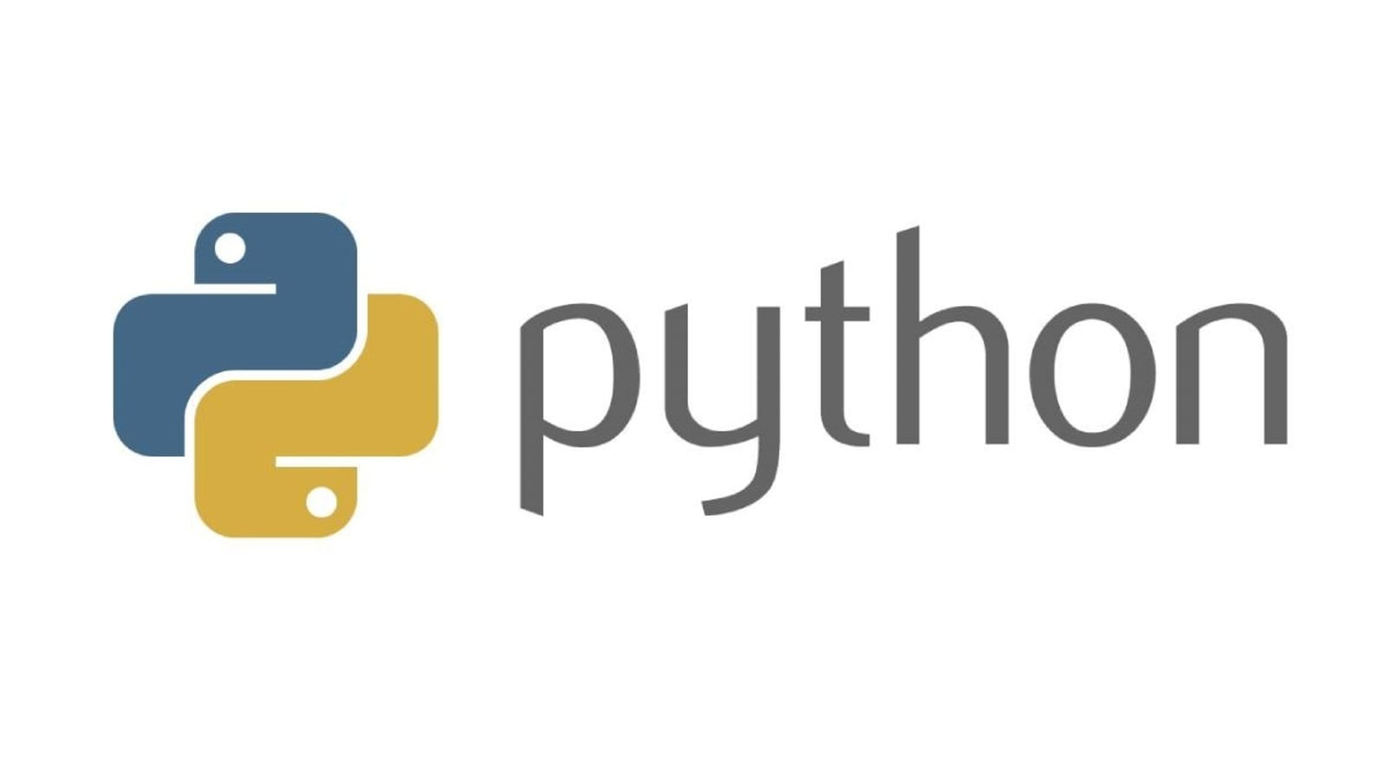
A brief history of Python
Guido van Rossum
A Dutch scientist
2020.1 :
Python 2 is
no longer
supported
Notes:
Guido is the main creator of the language. Until 2018, he also served as the BDFL (benevolent dictator for life) of Python, impacting decisions made to the language changes and updates.
In 1989, Van Rossum was working on Amoeba, a microkernel-based distributed system, for which he was developing system utilities. While working on them, Guido realized that developing in C takes too much time. He decided to spend his free time building a language that would help him accomplish his work faster.
Python is not named after the snake species, but after the British surreal comedy troupe Monty Python.
The word “Python” was also catchy, a bit edgy, and at the same time, it fit in the tradition of naming languages after famous people, like Pascal, Ada, and Eiffel.”
Python

Slide 34
How to learn Python well?
Practice, practice, practice !
https://pynative.com/python-exercises-with-solutions/
https://www.codesdope.com/practice/practice_python/
https://github.com/walter201230/Python
https://github.com/jackfrued/Python-100-Days
Learn by use
Get help from the Internet
google or bing

Slide 35
Install Python
Ways to install Python:
1. Full installer
https://www.python.org/downloads/
2. Anaconda:
https://www.anaconda.com/products/individual
Environment and package manager: Python & 1500+ packages
Notes:
https://open.oregonstate.education/computationalbiology/

Slide 36
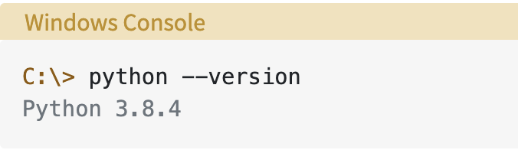
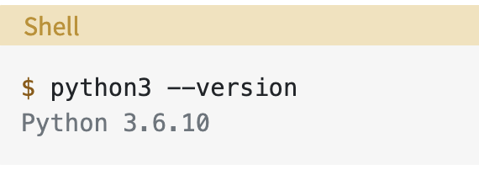
Install Python
Check if Python is installed on your laptop/computer
Windows:
Open cmd.exe (Win+R -> cmd)
Type ‘Python --version’
macOS & Linux:
Open Terminal
Type ‘Python --version’
Notes:
https://open.oregonstate.education/computationalbiology/

Slide 37
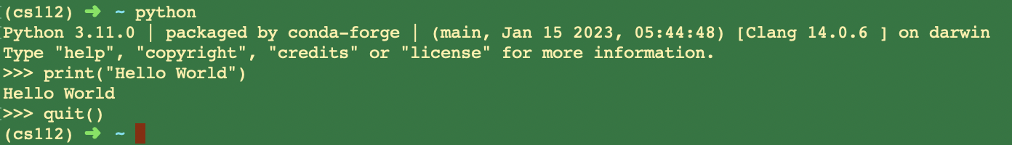
Working with Python
Command-line mode: talk directly to the interpreter
Type “python” in a Command line window
Type python commands
Quit by typing “quit()”
In this case, the Python interpreter will interpret and execute the commands as soon as you enter them

Slide 38
Working with Python
2. Scripting mode
Write code in a file (called script) with the .py suffix
Run code by typing “python scriptname.py”
Mac:
TextEdit (文本编辑器) -> New Document(新建文稿) -> Format (格式)-> Make plain text (制作纯文本) -> save ( as XXX.py file)
Windows:
Notepad(记事本) -> Save as (另存为) ->XXX.py

Slide 39
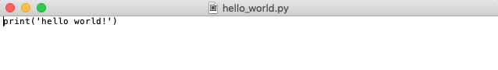
Working with Python
For example:
In a text editor, type “print("Hello World!")” and save the file as ‘hello_world.py’. Open command line tool, type “python” and a space. After the space, type in the path of the script.

Slide 40
Working with Python
3. Using IDE （integrated development environment）
集成开发环境
Features:
Syntax Highlighting
Autocomplete
Execution from Within the Environment
Debugging Support

Slide 41


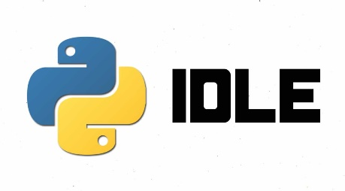
Working with Python
3. Using IDE （integrated development environment）
Other IDEs
Visual Studio
Visual Studio Code
Developed by Microsoft
IDLE
适用于 Windows 上 .NET 和 C++ 开发人员的最全面 IDE。 完整打包了一系列丰富的工具和功能，可提升和增强软件开发的每个阶段。
在 Windows、macOS 和 Linux 上运行的独立源代码编辑器。 JavaScript 和 Web 开发人员的最佳选择，具有几乎可支持任何编程语言的扩展。
安装python的时候自带的一个编辑器。

Slide 42
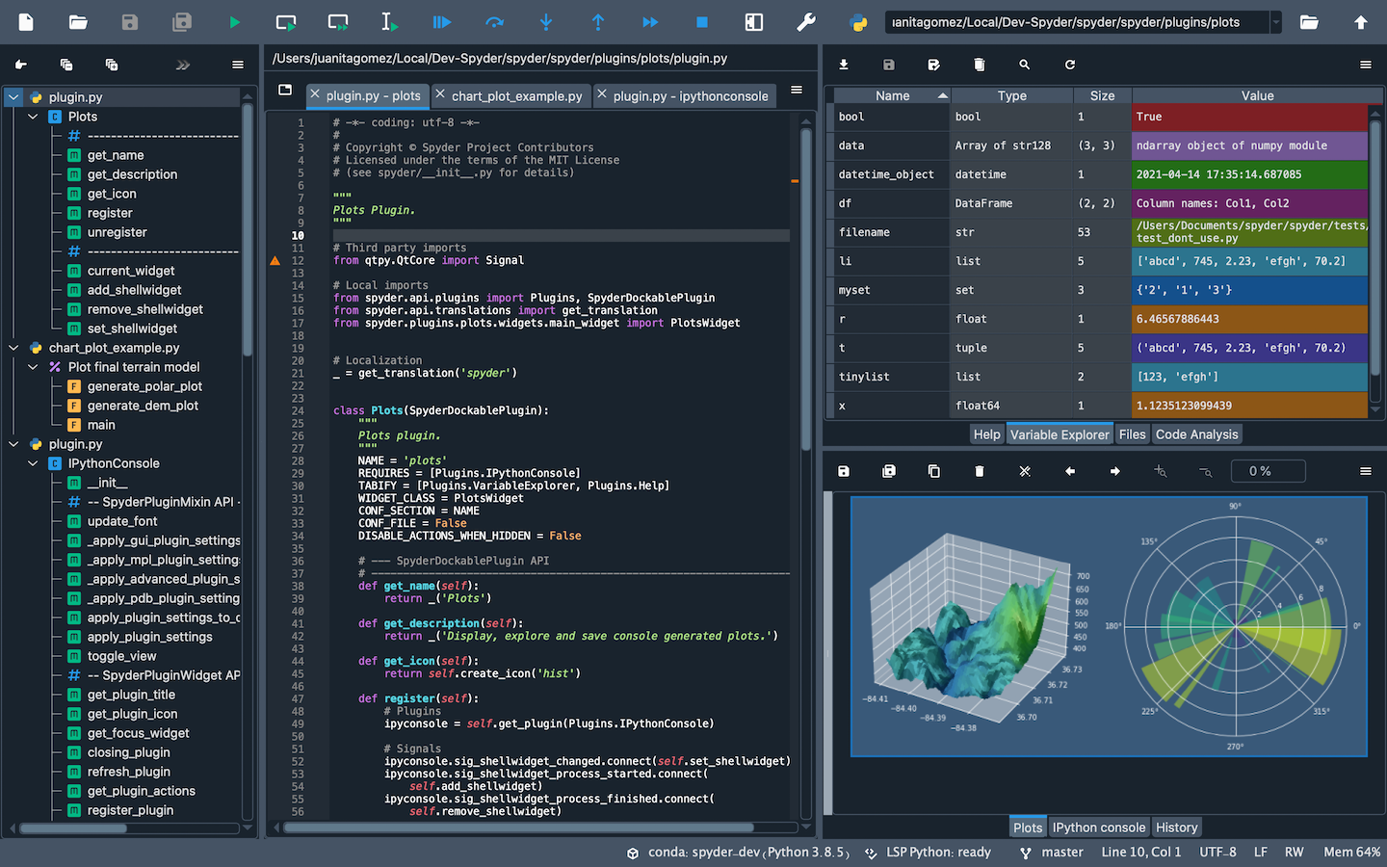

Working with Python
3. Using IDE （integrated development environment）
Example: Spyder (https://github.com/spyder-ide/spyder)
A free IDE for python included with Anaconda
www.spyder-ide.org

Slide 43
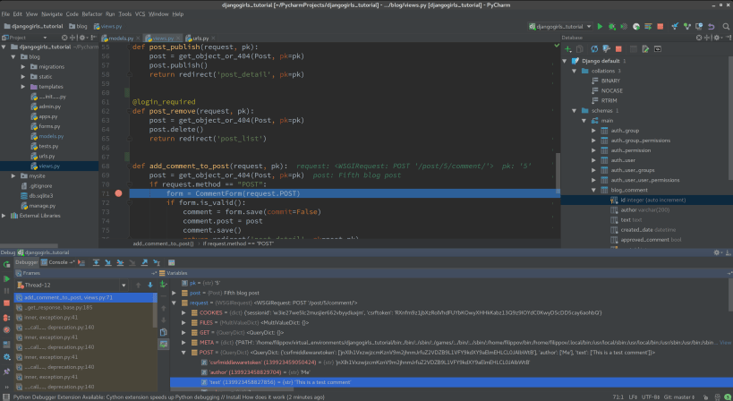

Working with Python
3. Using IDE （integrated development environment）
Example: Pycharm (https://www.jetbrains.com/pycharm/)

Slide 44
Working with Python
4. Using Jupyter Notebook
a web-based Python programming environment that allows you to create and edit documents that combine text, graphics and executable Python code.

Slide 45
The Jupyter Notebook
Jupyter Notebook is a notebook authoring application, under the Project Jupyter umbrella.
Jupyter Notebook offers fast, interactive new ways to prototype and explain your code, explore and visualize your data, and share your ideas with others.
A web application: A browser-based editing program for interactive authoring of computational notebooks which provides a fast interactive environment for prototyping and explaining code, exploring and visualizing data, and sharing ideas with others
Computational Notebook documents: A shareable document that combines computer code, plain language descriptions, data, rich visualizations like 3D models, charts, mathematics, graphs and figures, and interactive controls

Slide 46
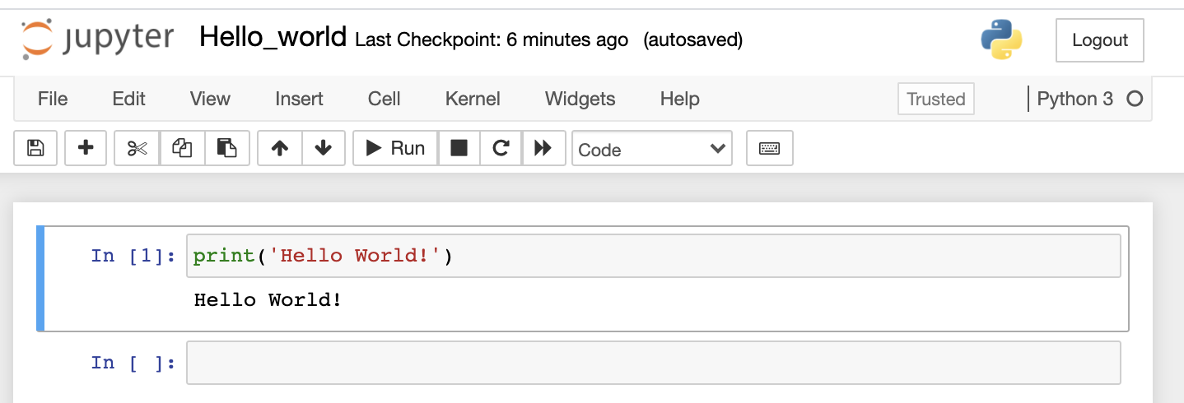
Working with Python
4. Using Jupyter Notebook
Create a notebook in Jupyter Notebook:
1. Anaconda -> Jupyter Notebook
2. In the web window, New -> Python3
3. Type codes in code cells, click ”Run” or press “Shift” + “Enter” to run the script in the selected code cell

Slide 47
Anaconda
Anaconda is a free and open-source distribution of the Python programming language for scientific computing (data science and machine-learning, etc.) related applications
Packages are managed by the package management system conda
Anaconda distribution comes with over 250 popular data science packages automatically installed

Slide 48
Anaconda：Install Python packages
1. Open an Anaconda Prompt (terminal on Linux or macOS)
2. Type: conda install package-name
Installing specific versions
conda install package-name=x.x.x
Example: To install pandas (https://pandas.pydata.org/):
$ conda install pandas
$ conda install pandas=1.2.0
Or
Search and install packages in Anaconda Navigator

Slide 49
Anaconda：Install Python packages
Update package: conda update
$ conda update pandas
Uninstall package: conda remove
$ conda remove pandas

Slide 50
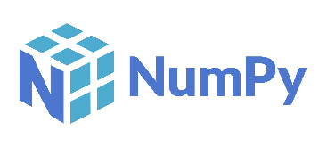

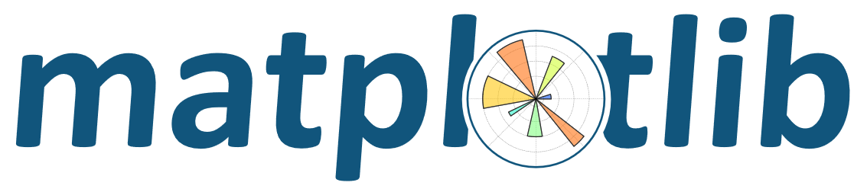

Python modules (packages)
NumPy
Numerical Python, a multidimensional array object (like a vector or matrix)
SciPy
Scientific Python, a very broad spectrum of scientific and numerical software: numerical differentiation and integration functions, solve differential equations, etc.
Matplotlib
a powerful plotting package written for Python and capable of producing publication-quality plots
Pandas
a powerful package for manipulating and analyzing data formatted and labeled in a manner similar to spreadsheets
Python modules can be accessed using import command

Slide 51
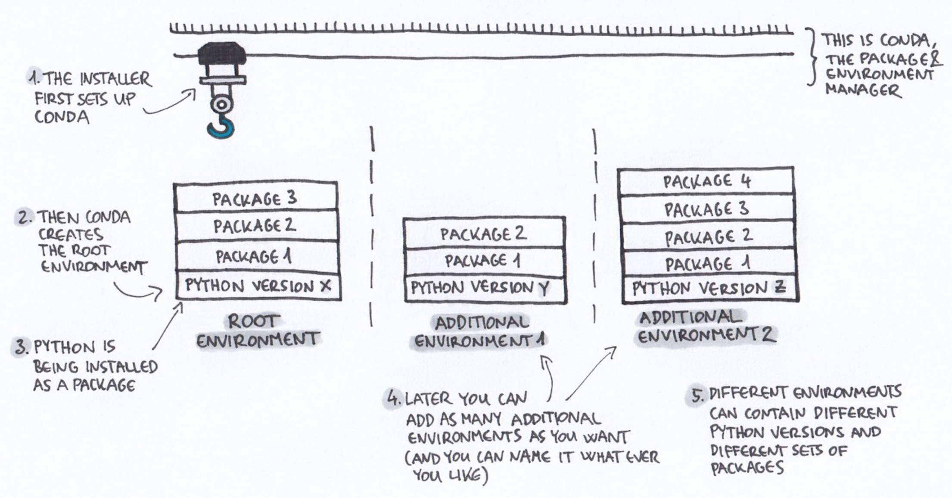
Anaconda：Virtual Environments
Environments allow different versions of packages on same machine
https://angus.readthedocs.io/en/2019/conda_tutorial.html

Slide 52
Anaconda：Virtual Environments
Environments allow different versions of packages on same machine
conda create --name [your_env_name] [package]
Examples:
Create environment “test” and install numpy version 1.19.0
conda create --name test numpy=1.19.0
Create environment “test2” and install numpy version 1.20.0
conda create --name test numpy=1.20.0

Slide 53
Anaconda：Virtual Environments
Environments must be activated
On Mac OS X and Linux:
$ source activate test
$ python ...
$ source deactivate
On Windows:
> activate test
> python ...
> deactivate

Slide 54
Anaconda：Virtual Environments
List packages in current conda environment:
$ conda list
Clone an environment
Export packages info
$ conda list -e > requirements.txt
Create an environment from the list of packages
$ conda create --name <env_name> --file requirements.txt

Slide 55
Anaconda：Virtual Environments
List all conda environments:
$ conda info --envs
Other conda commands:
See Blackboard -> conda-cheatsheet.pdf

Slide 56
Summary
Enjoy Python！
Try to do something with Python

